Slide 1









SOFTWARE COURSES MASTERCLASS
Visit Our Website
chanakyans.in

Slide 2




About Chanakyans
Chanakyans is an offline & online education platform to help individuals develop their professional potential in the most engaging learning environment. Our vision is to design and deliver a quality learning program to drive the growth of the sector and make India a global hub for Information technology & core engineering.
Our Ideology
“We intend to create intellectual curiosity, creativity & compassion in the students to build an industry-ready workforce to serve the corporates with the best talents. We intend to build a bridge between the industry & workforce by creating an ecosystem.”

Slide 3



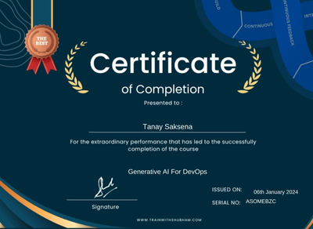


About Your Instructor
Tanay Saksena
Certified Ethical hacker
Forensic investigator
EC Council Certified
Cyber Security, Cloud Computing & DevOps career mentor
6+ Years of experience
Worked as AWS cloud engineer & AWS devops engineer

Slide 4


What are the career options to enter in Software Industry?
Understanding what paths are available to you can help you navigate your first steps as you begin your career in IT. The world of IT offers a variety of career paths in diverse industries.
An IT professional can specialize in cybersecurity to keep computers safe, cloud computing to make information easier to access, or Analyse Data & Develop smart softwares using AI & Machine Learning or using full stack programming languages.
Data Science, Machine Learning & AI
Full Stack Development (Web & App)
Cyber Security & Ethical Hacking
Cloud Computing & DevOps

Slide 5








Why Data Science?
What will you earn?
How much is too much?
Data Science jobs are currently some of the most paying in India, with an average annual salary range of ₹ 6 Lakhs to ₹ 25 Lakhs.
The world produces
2,500,000,000,000,000,000+ bytes
of data every day, that’s equal to 10 million
Blu-Ray disks stacked the height of 4 Eiffel Towers.
Who can do it?
What will you do?
Any Graduate or pursuing candidate can start learning data science.
No prior Coding knowledge required.
A Data Scientist solves problems with large amounts of data.
Example: Analyze tweets to figure out whether or not a tweet sent to a company is positive or negative.
What will they call you?
What’s the demand?
3 common roles in Data Science
Data Scientist
Data Engineer
Data Analyst
The US alone will face a shortage of 150,000+ data analysts and an additional 1.5 million data-savvy managers

Slide 6






Industries Looking For
Data Scientist/ Data Analyst
Education & Development
Transportation & E-commerce
To update & upgrade prescribed literature
for rapid growth
For better managing logistics & traffic plan
To Predict & manage staffing & inventory requirements from time to time.
Healthcare & Medicine Research
Communication & Media
To collect public health reports and identify global data with the spread of virus or diseases.
For Simultaneous real-time reports of several platforms
Financial Institutions
Insurance & Investments
Banking & Securities Institutions
Helps in Reducing Fraudulent Transactions
For developing new products & handling claims through analytics

Slide 7
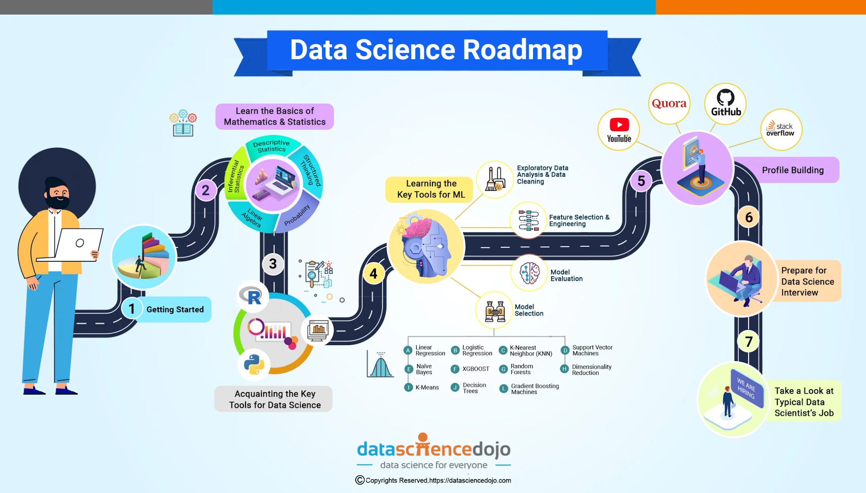
Data Science Roadmap

Slide 8








Full Stack Development (Website & App)
Salary Packages
Target Objectives
Salary in India ranges between ₹ 4.8 Lakhs to ₹ 16.0 Lakhs with an average
annual salary of ₹ 9.1 Lakhs
A full-stack developer helps build and maintain both the front-end and the back-end of a website.
Eligibility or Experience
Task Objectives
Any aspiring person can become a full-stack developer; the same goes for a non-IT person.
The main task of a full-stack developer is to create a product from scratch and supervise the general flow of the project.
Learning Tech Stack
Industry Demand
HTML/CSS, JavaScript, Frontend frameworks.
Backend technologies, Databases and web storage, AI coding, Git/GitHub, HTTP and REST.
Full stack developer is among the highest paying jobs in India. But there is still a scarcity of these IT professionals in the field of web development.

Slide 9




Full Stack Developer - Tech Stack
Front End Development
Back-end Development
Database Management
Cloud Computing & DevOps
Mobile App Development
HTML
CSS
JAVASCRIPT libraries such as jQuery, ReactJS
Frameworks such as Angular, VUE, Backbone, Ember
Bootstrap
Python (Django, Flask, Pylons)
Ruby (Ruby on rails)
Java (Spring)
NodeJS
PHP (Laravel)
MySQL
PostgreSQL
MongoDB
CouchDB
Redis
AWS
Azure
GCP
Oracle Cloud
KOTLIN
React Native
Swift
Java

Slide 10







Cyber Security & Ethical Hacking
Job Opportunities
Job roles such as Cybersecurity Analyst, Penetration Tester (Ethical Hacker), Security Consultant, Incident Responder, Security Engineer, Security Researcher, Information Security Manager, Network Security Engineer, Forensic Analyst and Security Architect.
Why Cyber Security & ethical hacking?
Cybersecurity and ethical hacking are crucial for securing online data, user authentication, and privacy protection.
Industries That Are Hiring
Eligibility
Our course is open to all. Whether you’re a student pursuing Commerce, Arts, Engineering, or Science, you can dive into the world of Cybersecurity and Ethical Hacking.
Sectors including finance, healthcare, technology, government, e-commerce, telecommunications, energy, consulting, automotive, education, transportation, and media.
Tools To Learn
Classroom Projects
10+ Tools & Technologies, 7+ Generative AI Tools, Libraries & Technologies Covered
Highlighting a selection of real-world projects and case studies supported by leading companies across industries

Slide 11






Opportunities In Cyber Security & Ethical Hacking
Auditing
Engineer
Cyber Security Auditor
IT Compliance Auditor
Security COntrol Assessor
Security Engineer
Application Security Engineer
Cloud Security Engineer
Network Security Engineer
Response
Testing & Analysis
Incident Responder
Cyber security Incident Manager
Forensic Analyst
Penetration Tester
Vulnerability Assessor
Security Auditor
Cyber Security Analyst
Threat Intelligence Analyst
Security Operations Center Analyst
Intrusion Analyst

Slide 12







Cloud Computing & DevOps
Cloud computing is utilized across industries for hosting enterprise applications, web and mobile applications, big data analytics, IoT deployments, and AI and machine learning projects.
Continuous Learning and Adaptability
Proficiency in Cloud Platforms and Technologies
DevOps Principles
Problem-Solving & Analytical Skills
Virtualization and Containerization
VMware, Docker
Automation and Scripting Skills
Networking and Security

Slide 13

What are the roles of
Cloud / DevOps Engineer
Designing and implementing DevOps solutions on AWS
Working with development, QA, and
operations teams to automate the build,
test, and deploy process
Deciding on and putting into practice the safest and quickest method for getting code from development to production
Creating and maintaining deployment pipelines and infrastructure as code
Monitoring system performance and capacity utilization

Slide 14

Career Options & Salary Range
Cloud Architect:
Average Salary: ₹23,61,456 Per Year
Cloud Engineer:
Average Salary: ₹14,26,721 per year
Cloud Developer:
Average Salary: ₹ 11.9 Lakhs per Year
Devops Engineer:
Average Salary: ₹10,41,024 per year
Cloud Consultant:
Average Salary: ₹ 13.9 Lakhs per Year

Slide 15
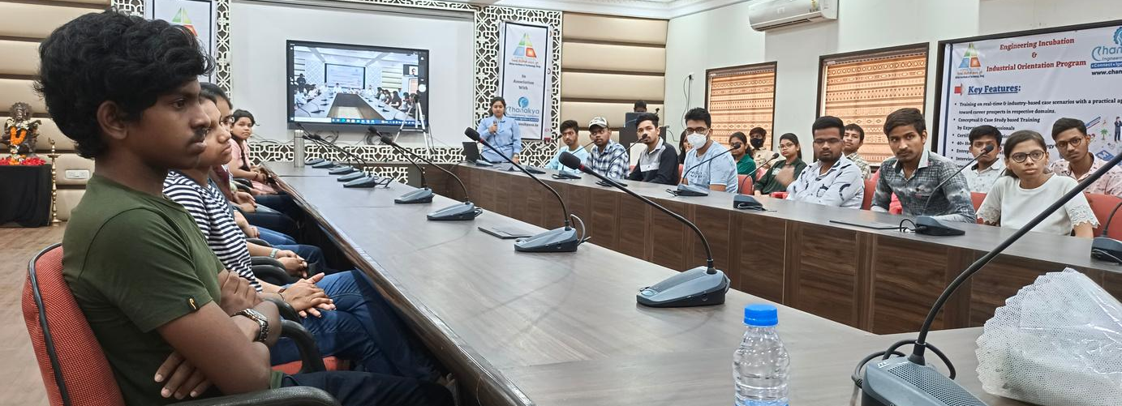
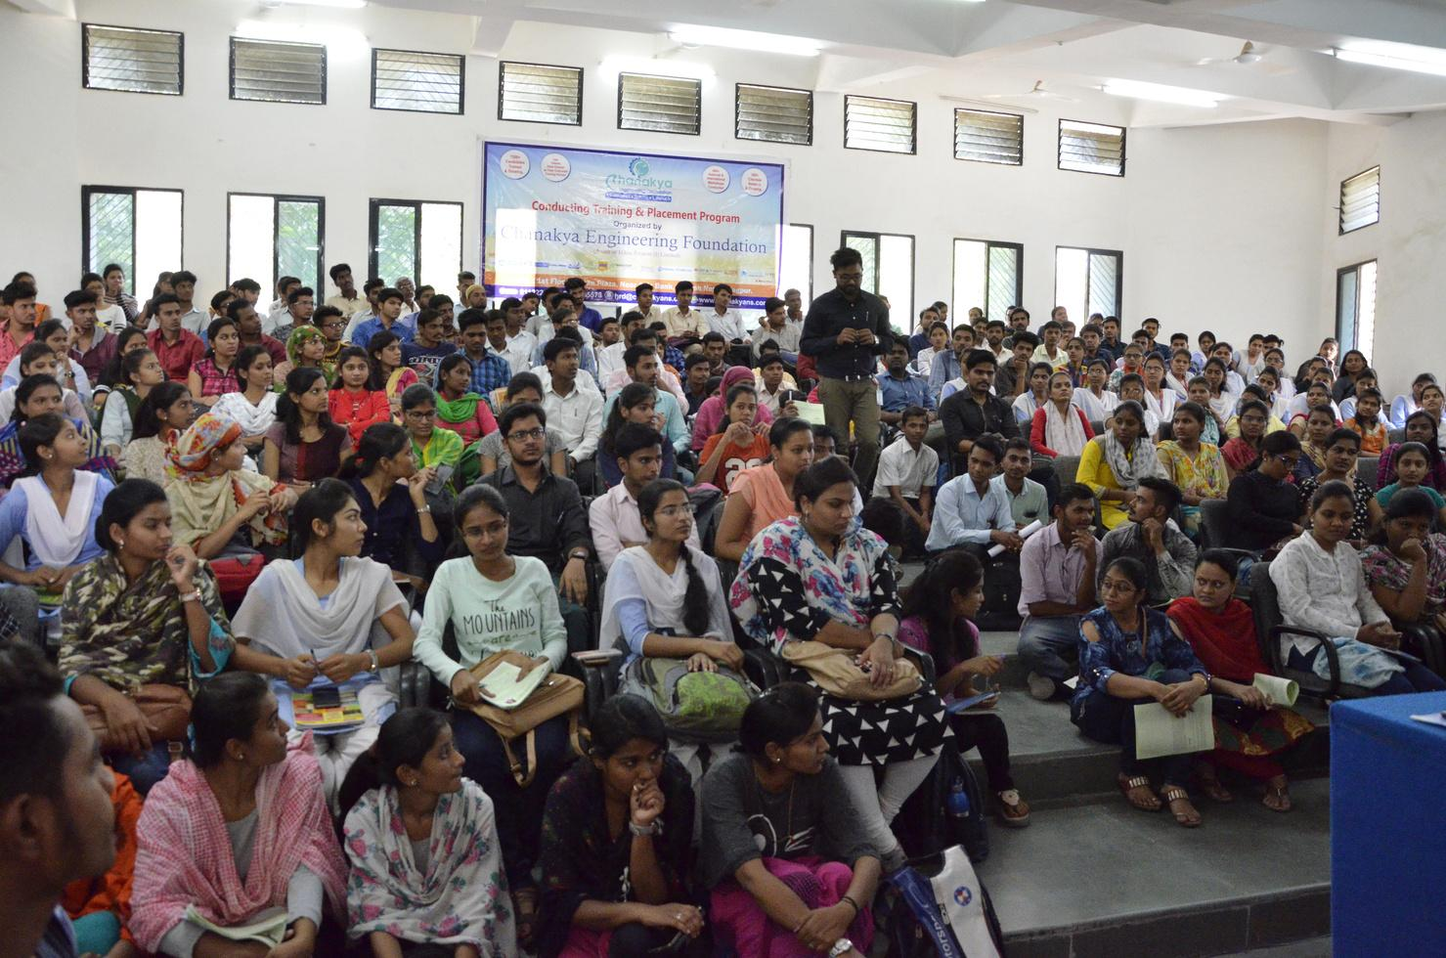
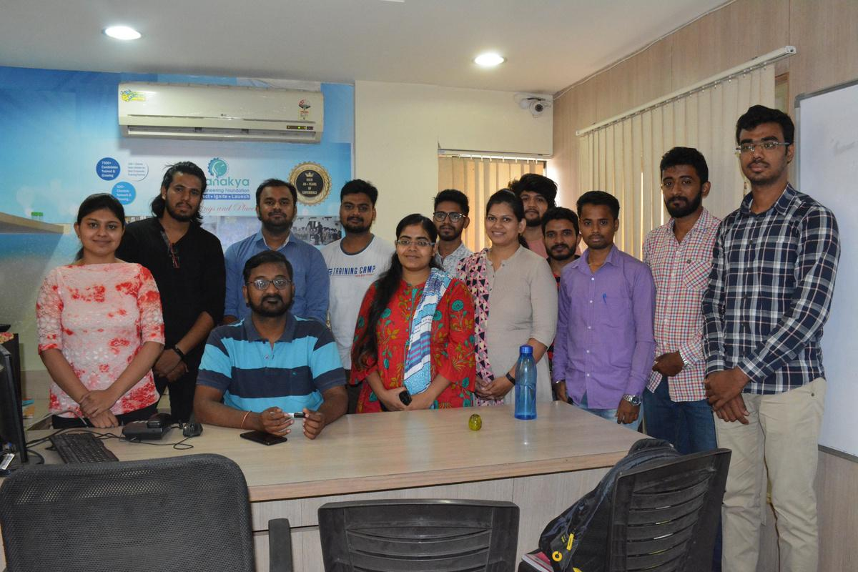
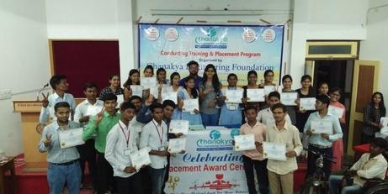
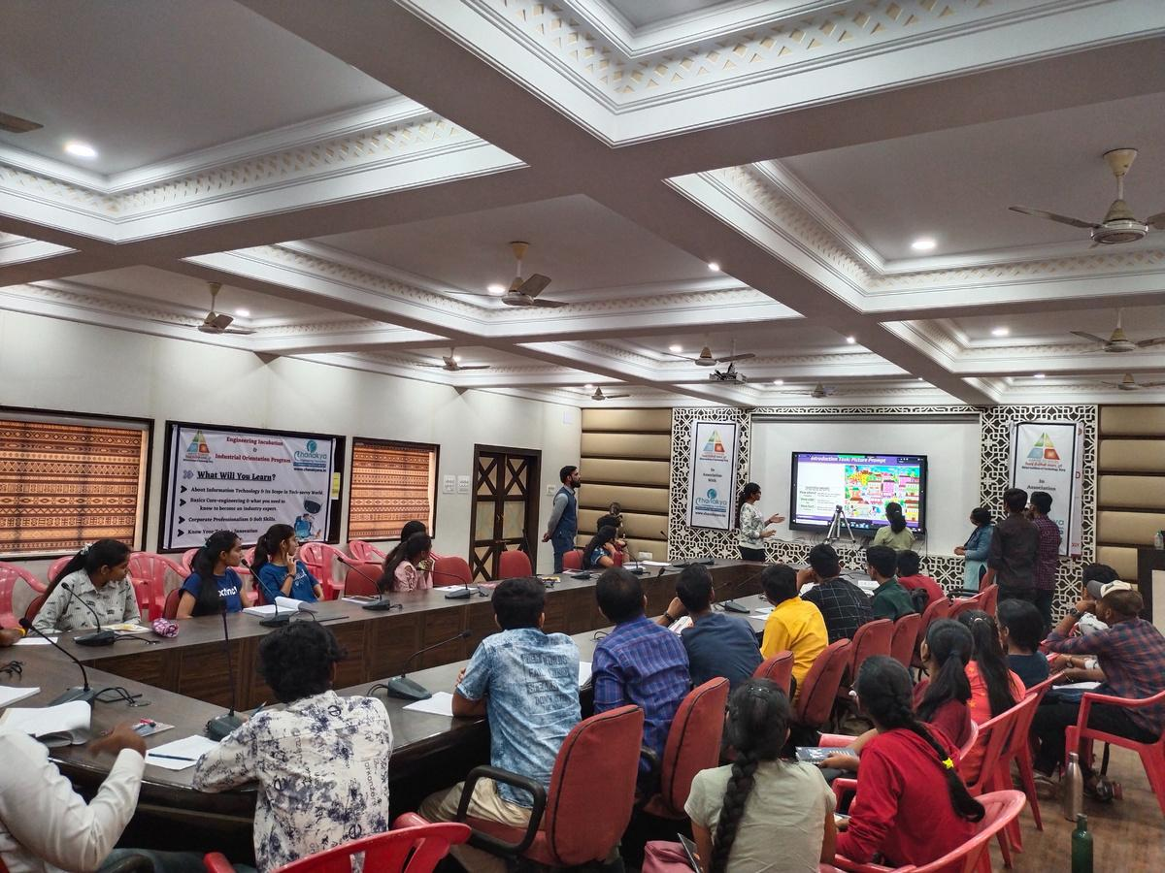
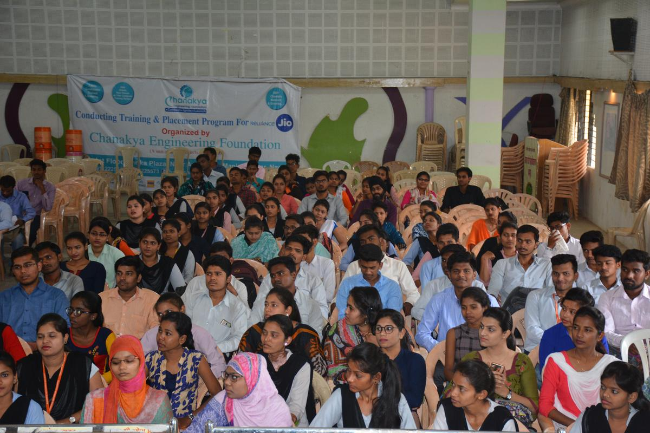
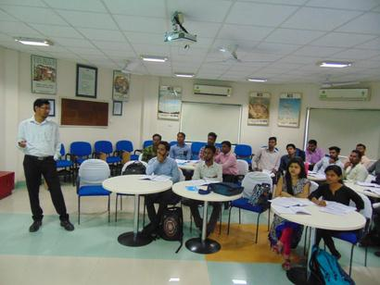
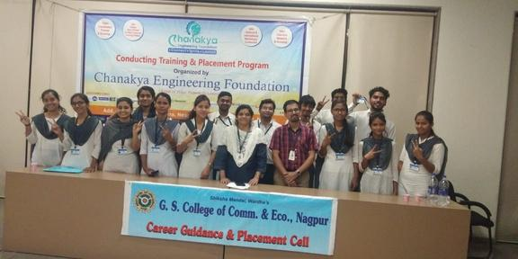


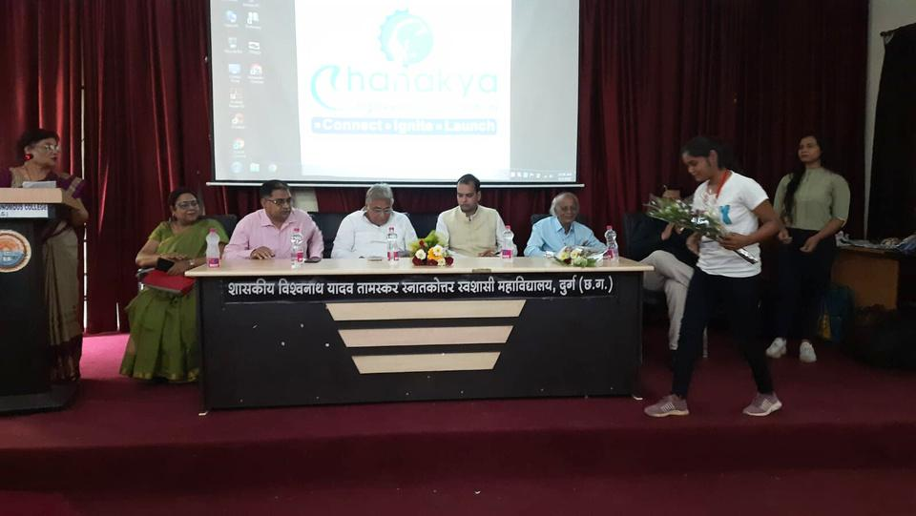
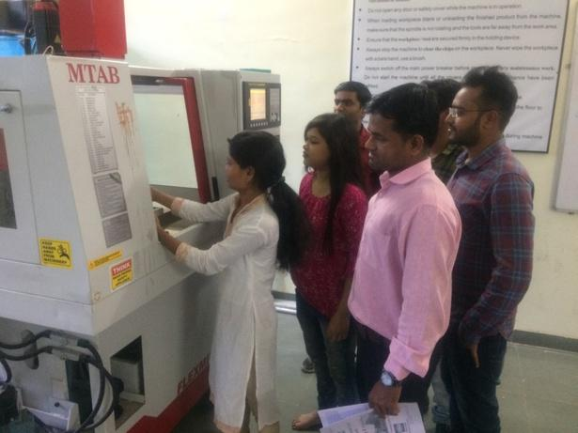
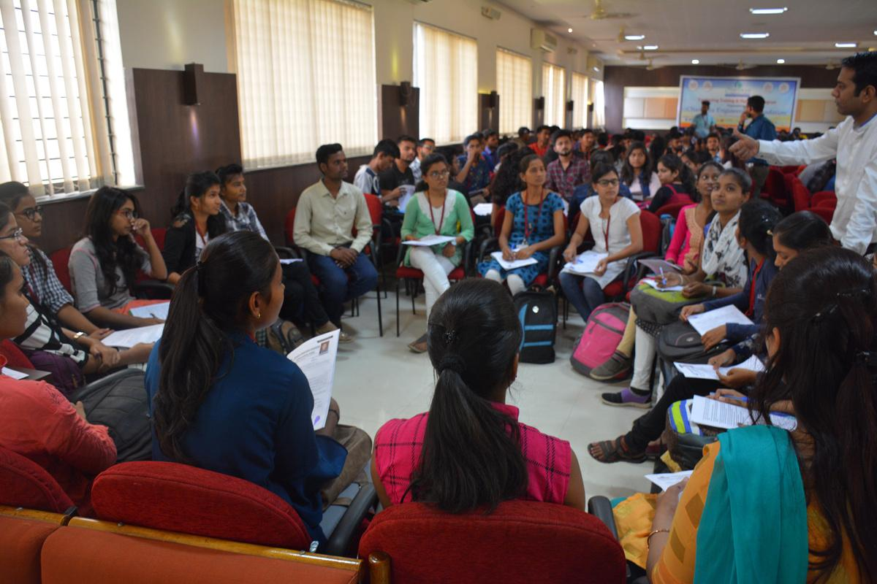
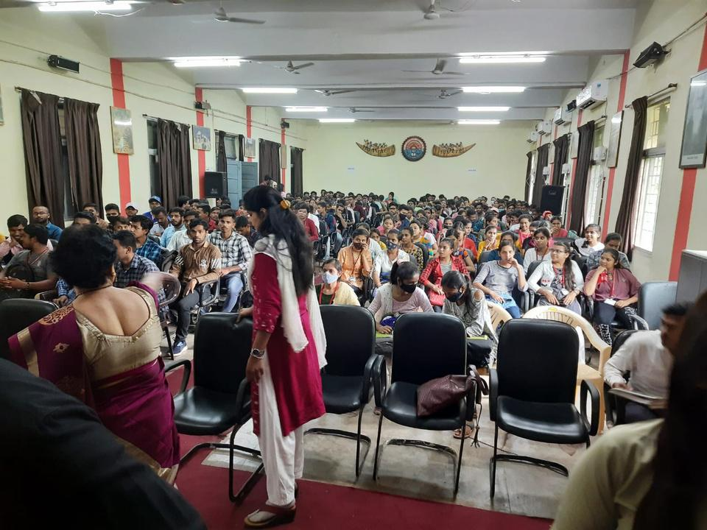
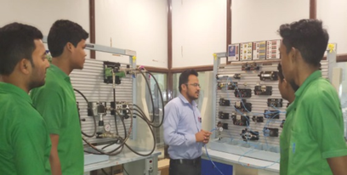
Our Recruitment Drives
On-site Training @

Slide 16
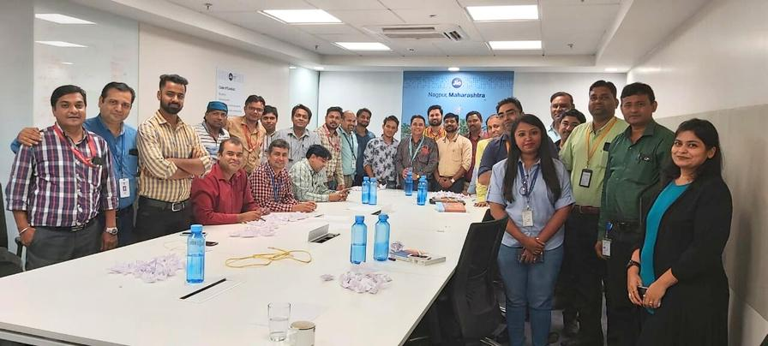
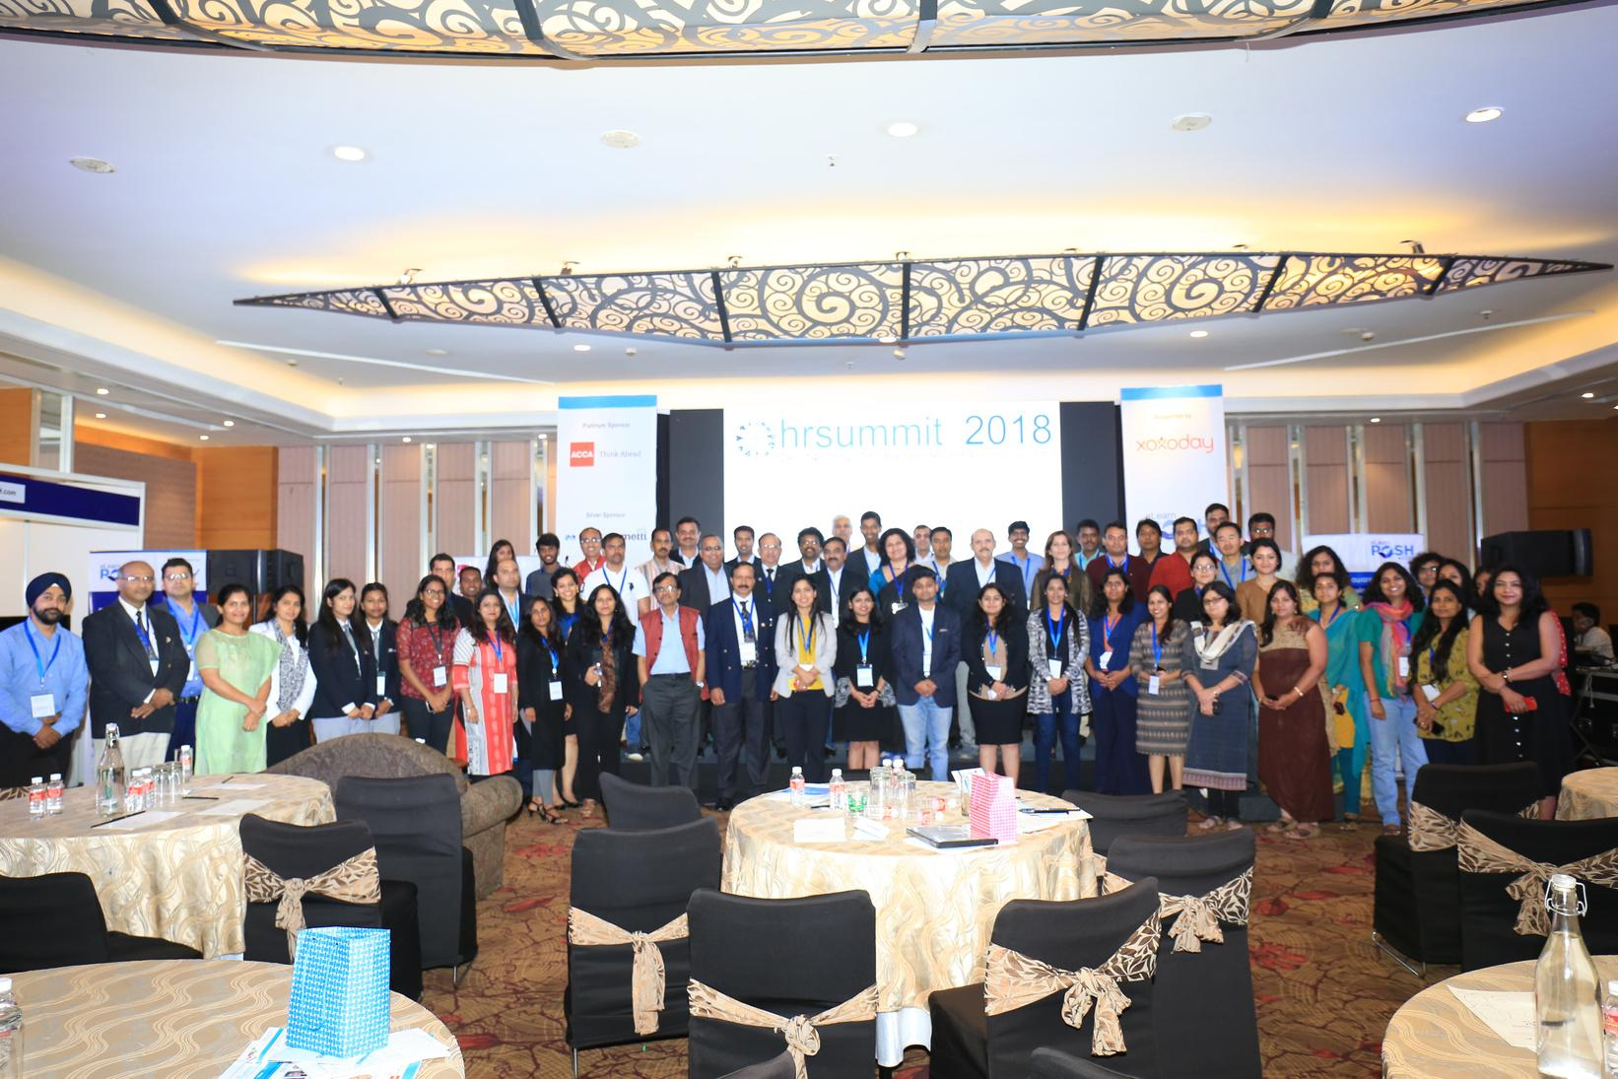
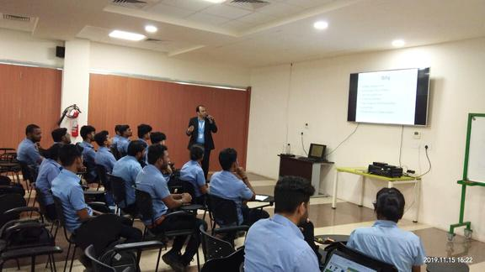
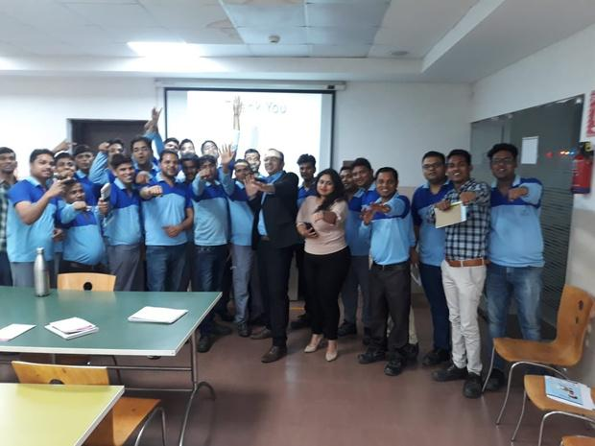

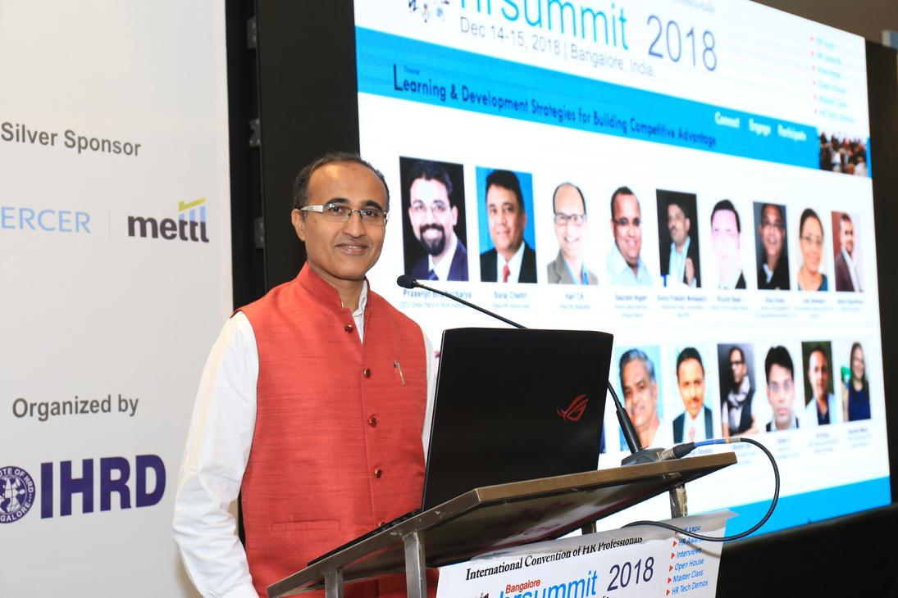
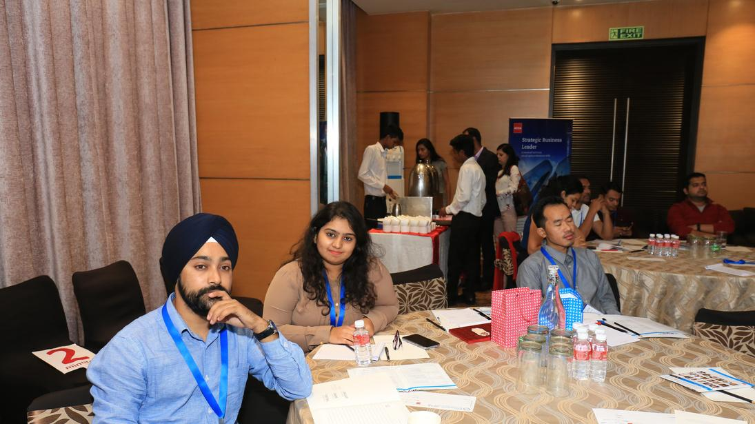


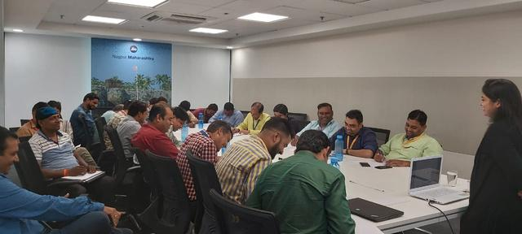
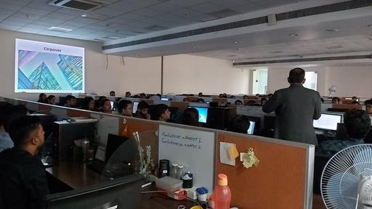
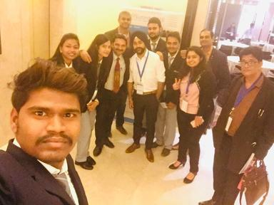
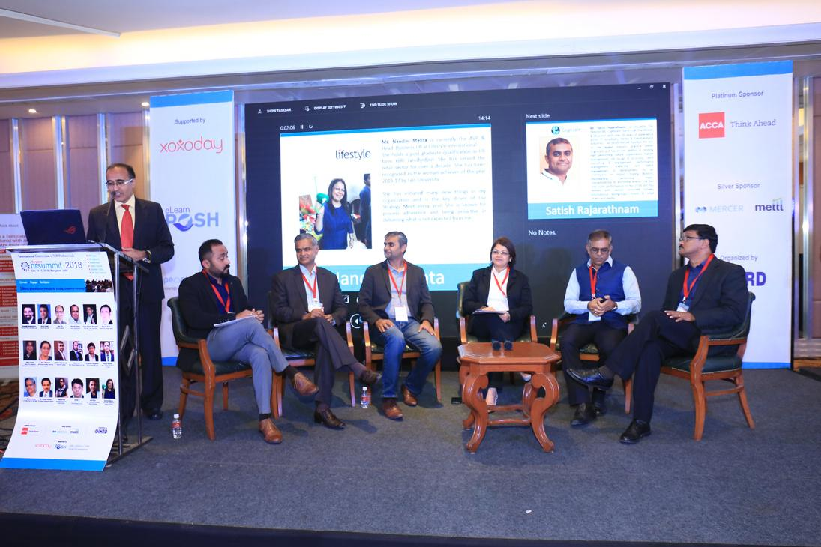
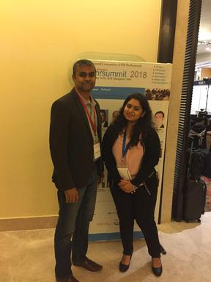
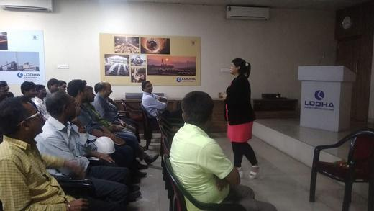
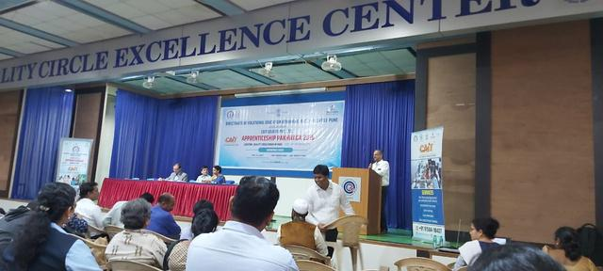

















Our Corporate Relations
AND MANY MORE….
AND MANY MORE….

Slide 17


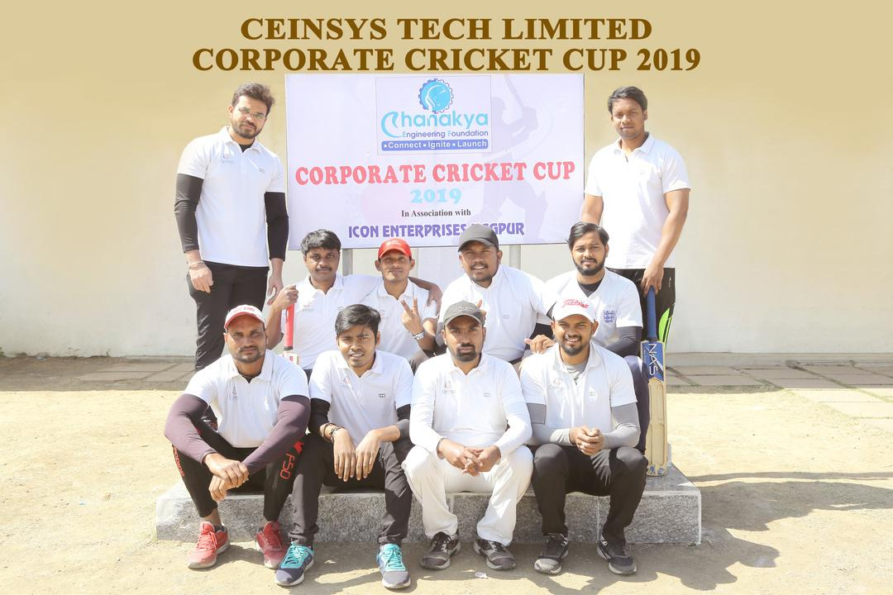
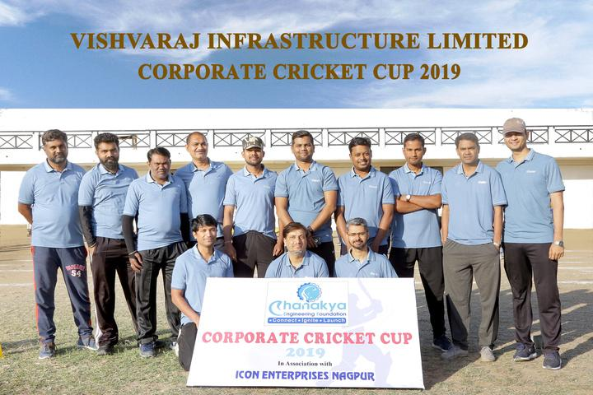



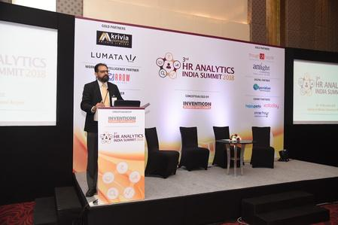



























Our Corporate Events
AND MANY MORE….
AND MANY MORE….

Slide 18















Our Top Recruiters
AND MANY MORE….

Slide 19
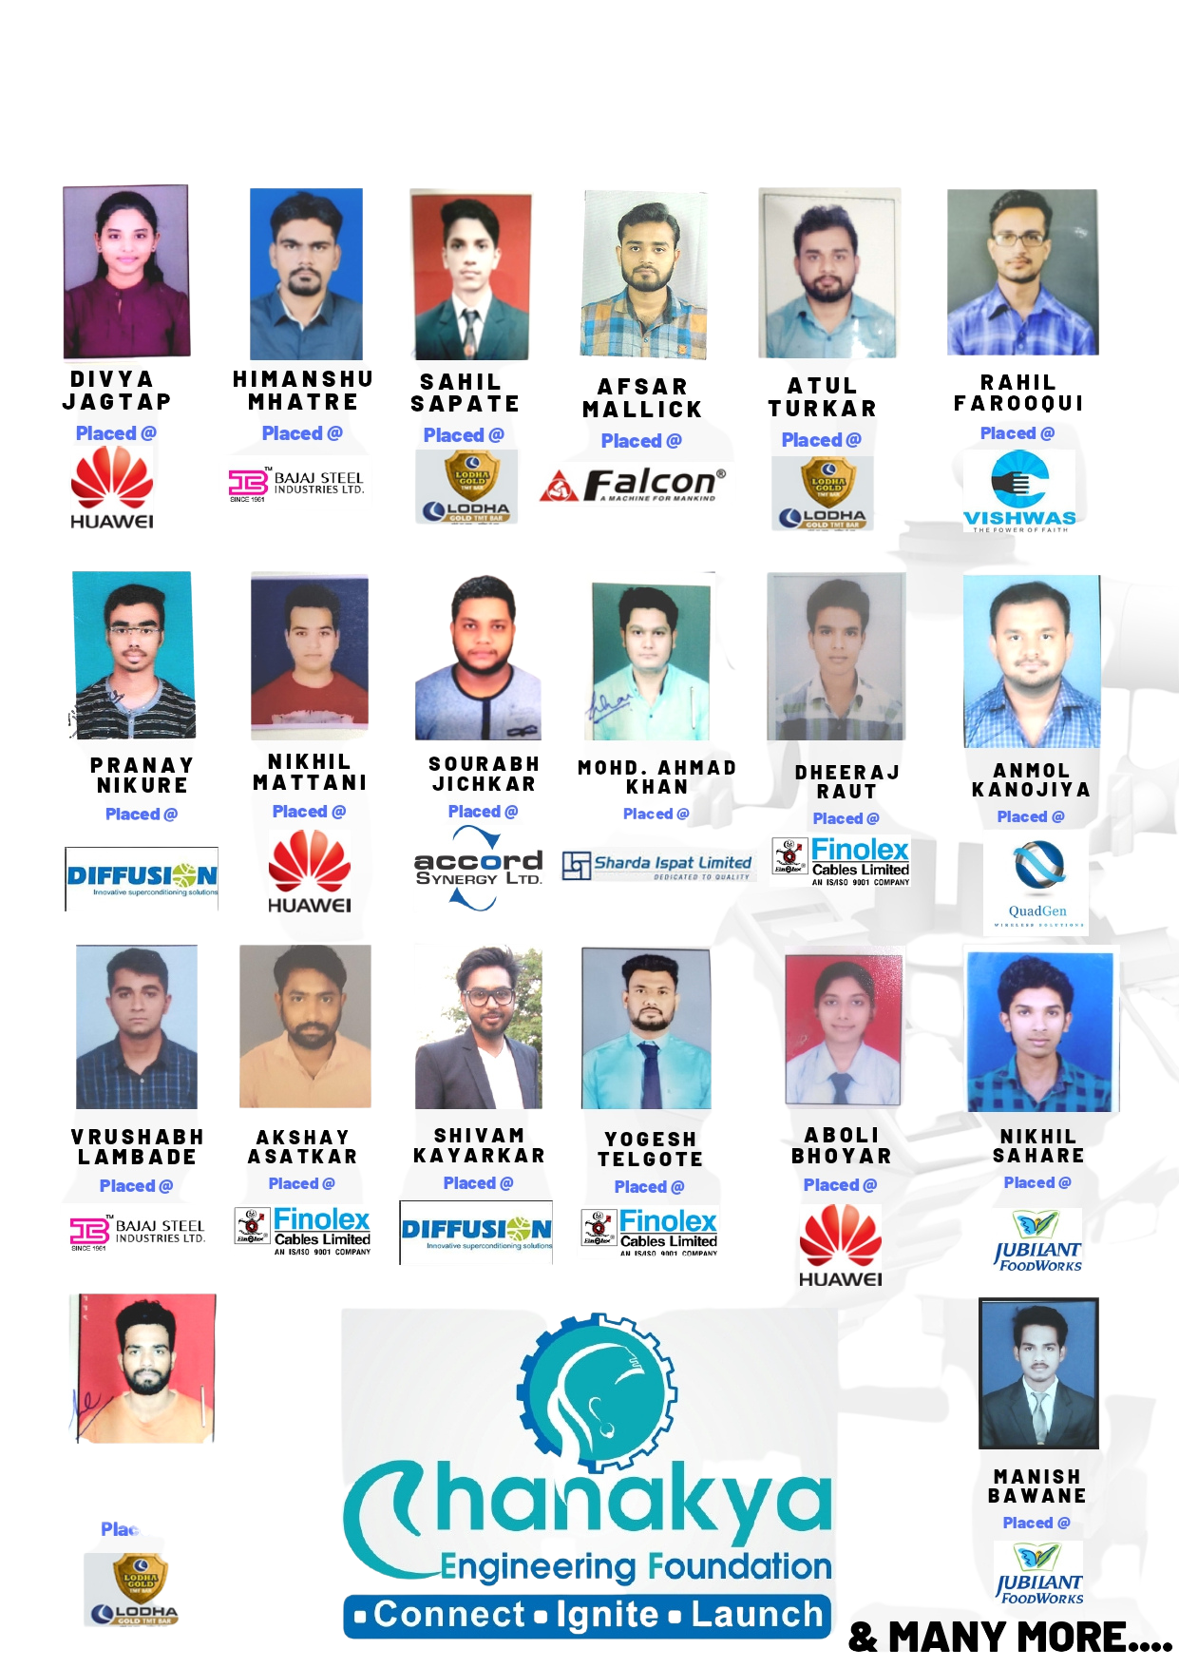
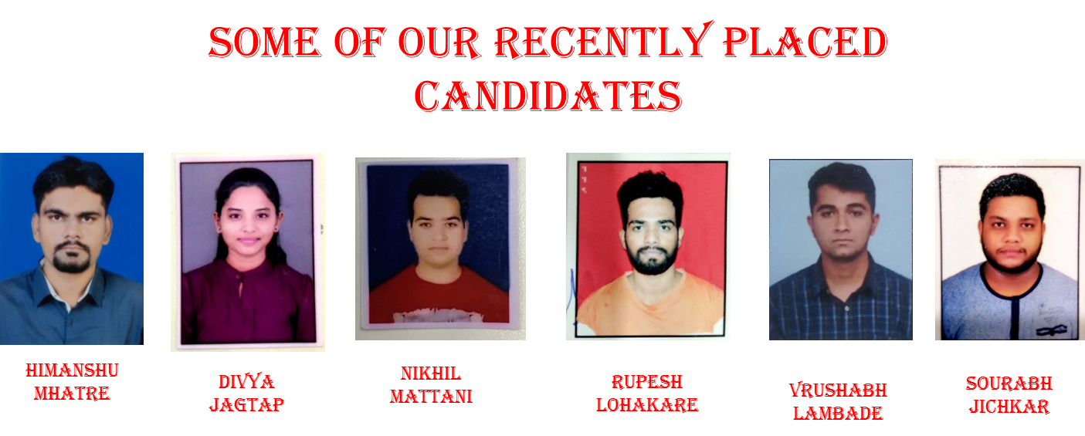
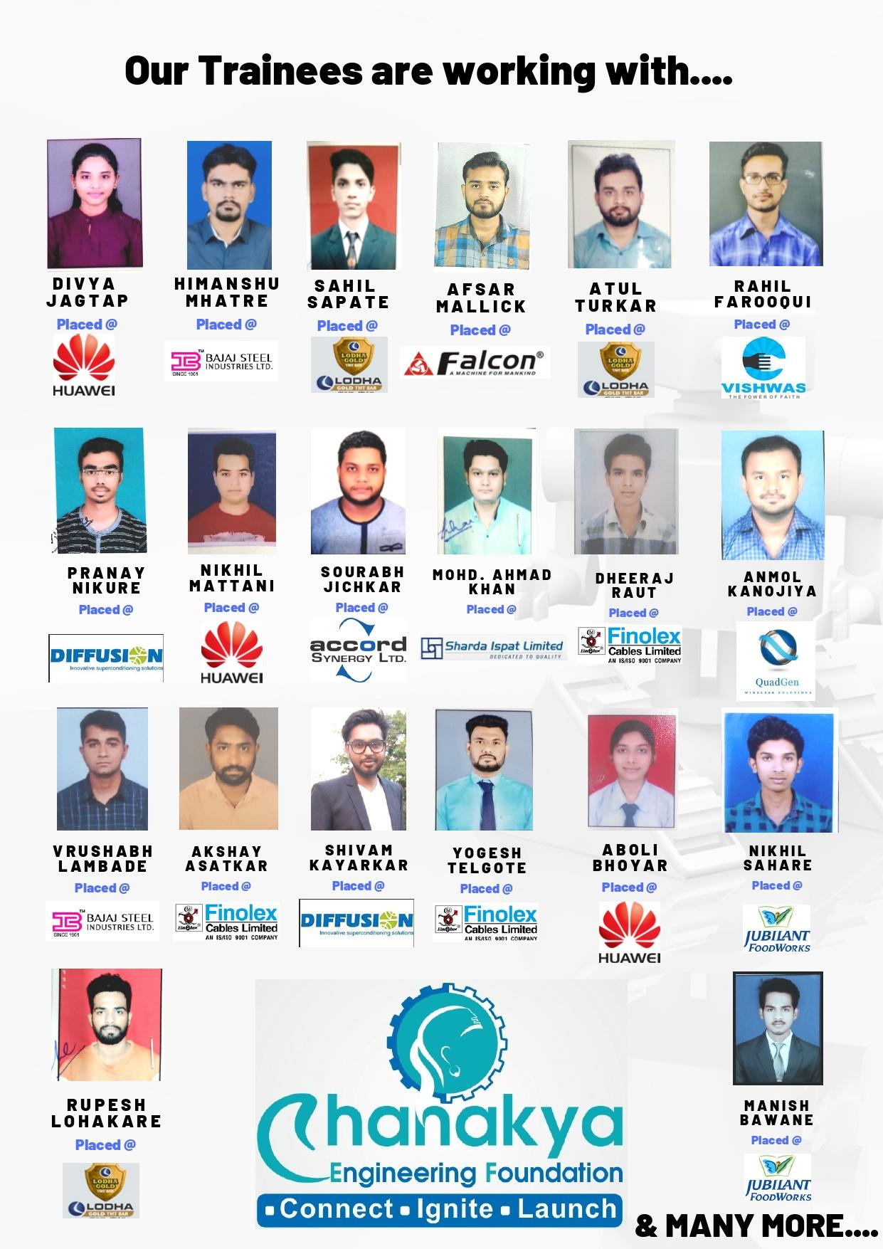
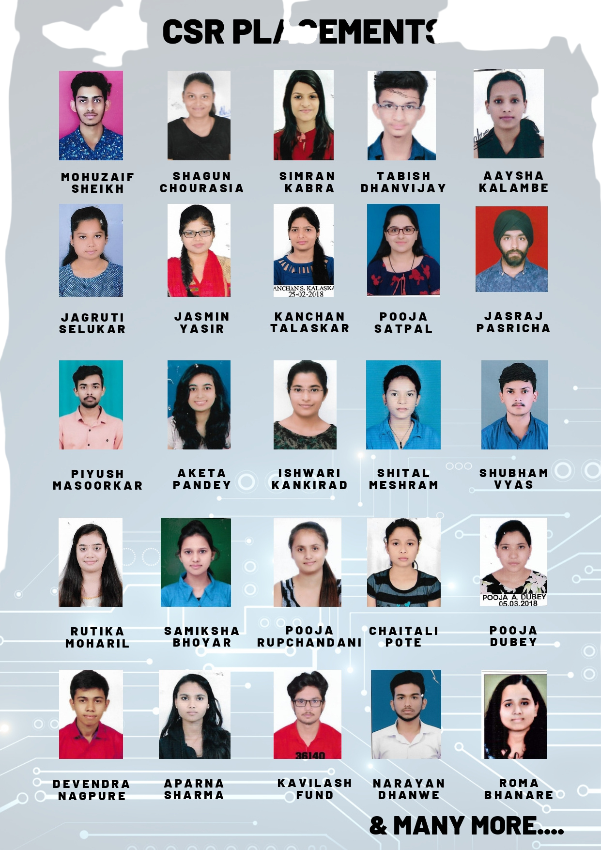

Our Candidates Placed in MNCs
Manish
Bawane
Devendra
nagpure
Himanshu
Mhatre
Divya Jagtap
Nikhil Mattani
Aparna
Sharma
Kavilash
Funde
Narayan
Dhanwe
Sahil Sapate
Aboli Bhoyar
Atul Sahu
Chaitali
Pote
Pooja
Rupchandani
Samiksha
Bhoyar
Rutika
Mohari
Pooja
Dubey
shubham
vyas
Simran Kaur
Tabish Dhanvijay
Ahmed Khan
AND MANY MORE….

Slide 20







Connect With Us
Raipur Branch - UNNMUKH, Sector 1, Nr Axis Juice Corner, Devendra Nagar, Raipur, CG, 492004
Bhilai Branch - BIZOFFICE, Off. No.- 4, Agrasen Chowk, Nehru Nagar, Bhilai, CG, 490020
Bangalore Head Office - HUBNXTDOOR, Kothnur Main Rd, JP Nagar P-7, Bangalore, Karnataka 560078
7038313885, 8602755547
www.chanakyans.in
contact@chanakyans.in
Chanakyans_edu

Slide 21

Thank You
For Your Attention
Visit Our Website
chanakyans.in

